Slide 1
Data Visualization: Empowering Business with Effective Insights
TATA Insights and Quants

Slide 2
AGENDA
Introduction
Data Processing
Exploratory Data Visualization

Slide 3
INTRODUCTION
The purpose of this visual analysis is to show metrics that can evaluate business performance. The analysis can help in giving insights in marketing strategies, customer buying behavior and showing revenue information of the company.

Slide 4
DATA PROCESSING
The data is processed with Power BI by sorting and filtering the data to remove unwanted values that can interfere with the results of our analysis. I removed values from the quantity column that shows negative values. I also removed unit prices that are below $0.I have also made revenue column by multiplying quantity with price. Aside from these corrections, the data is accurate and relevant to answer the business tasks.

Slide 5
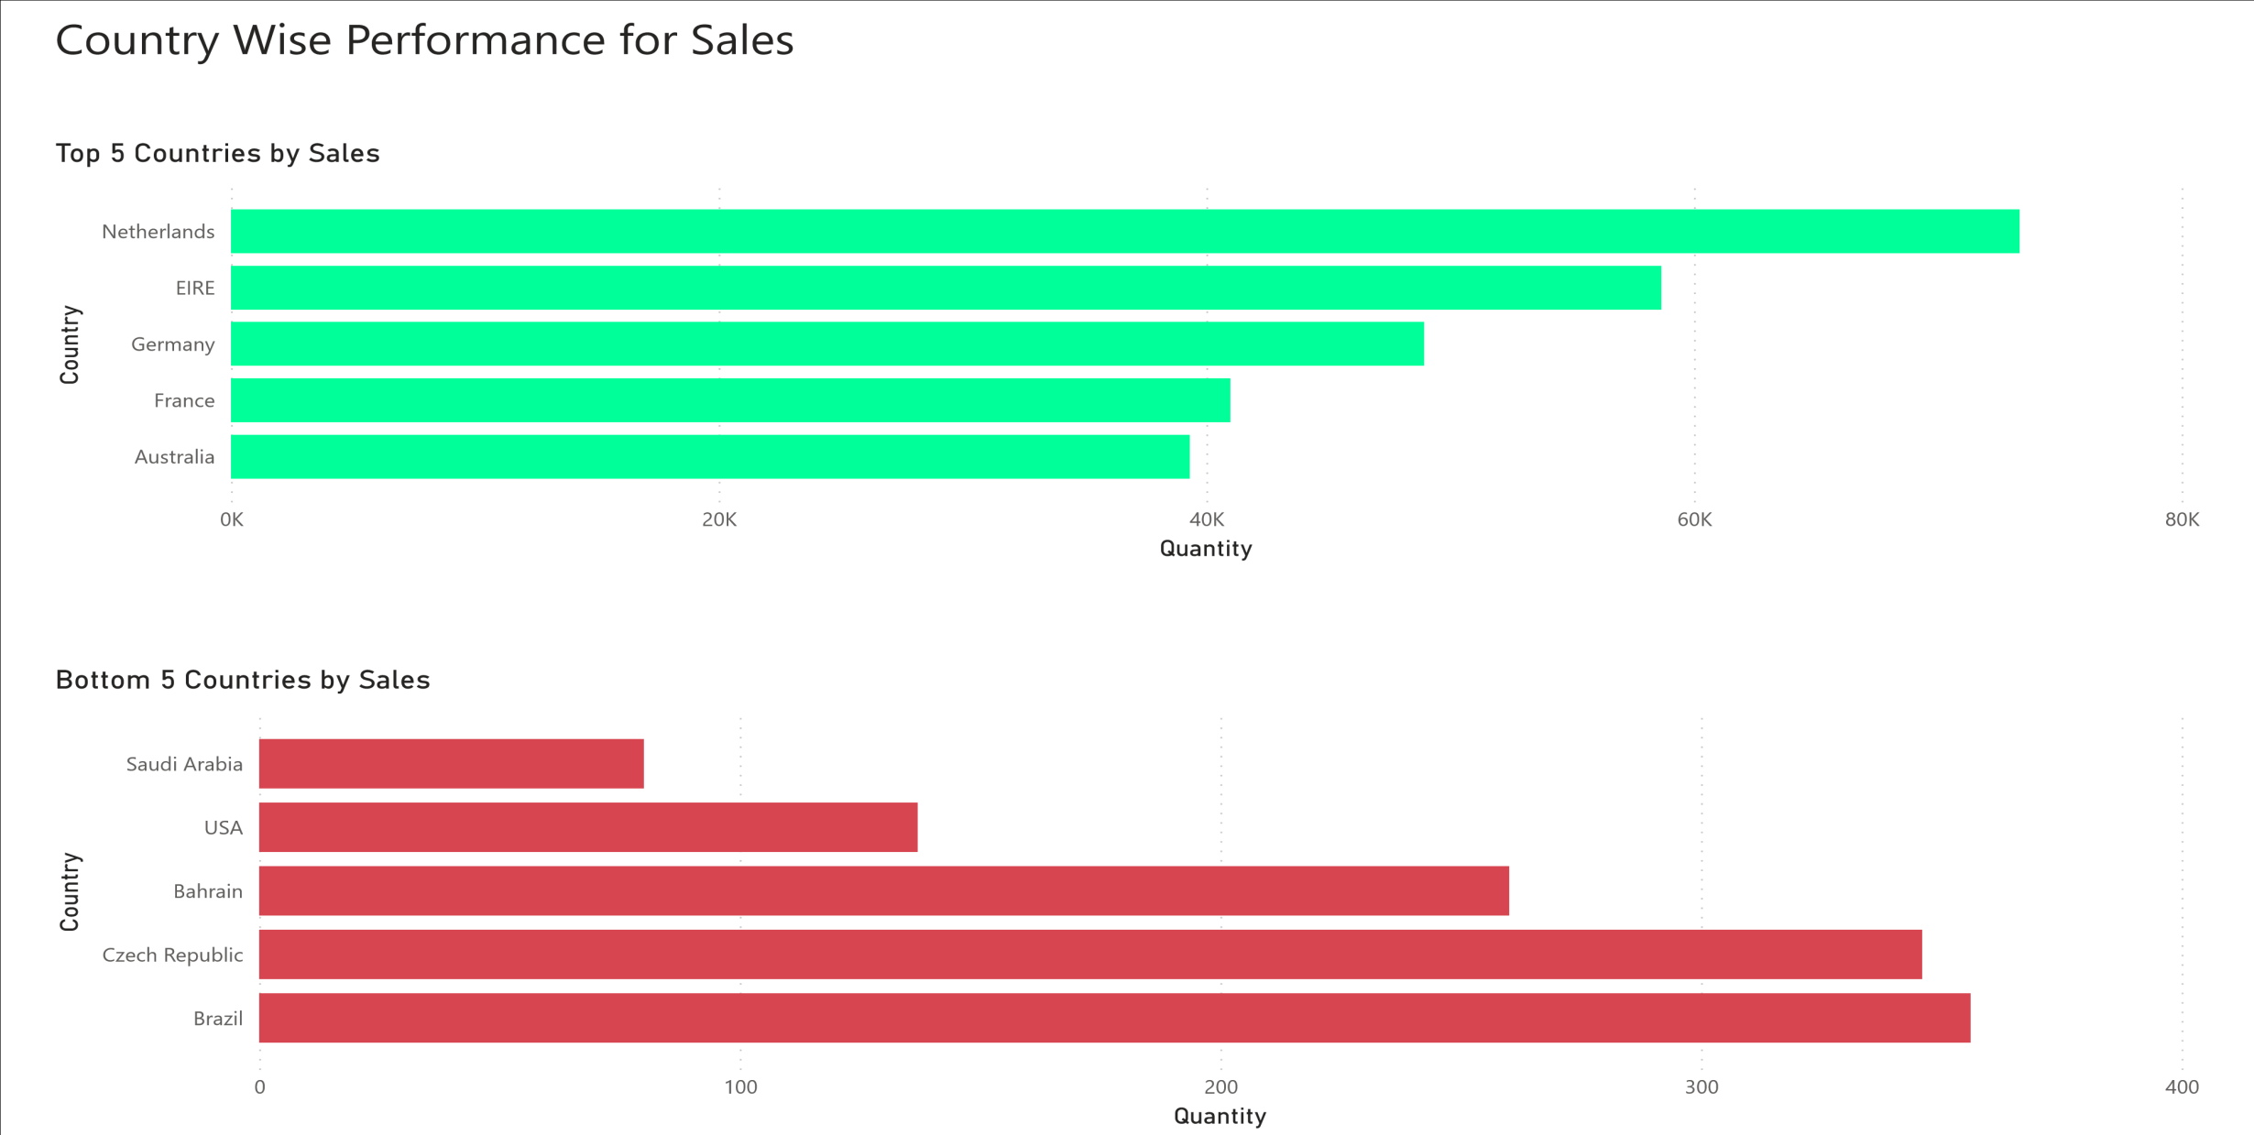
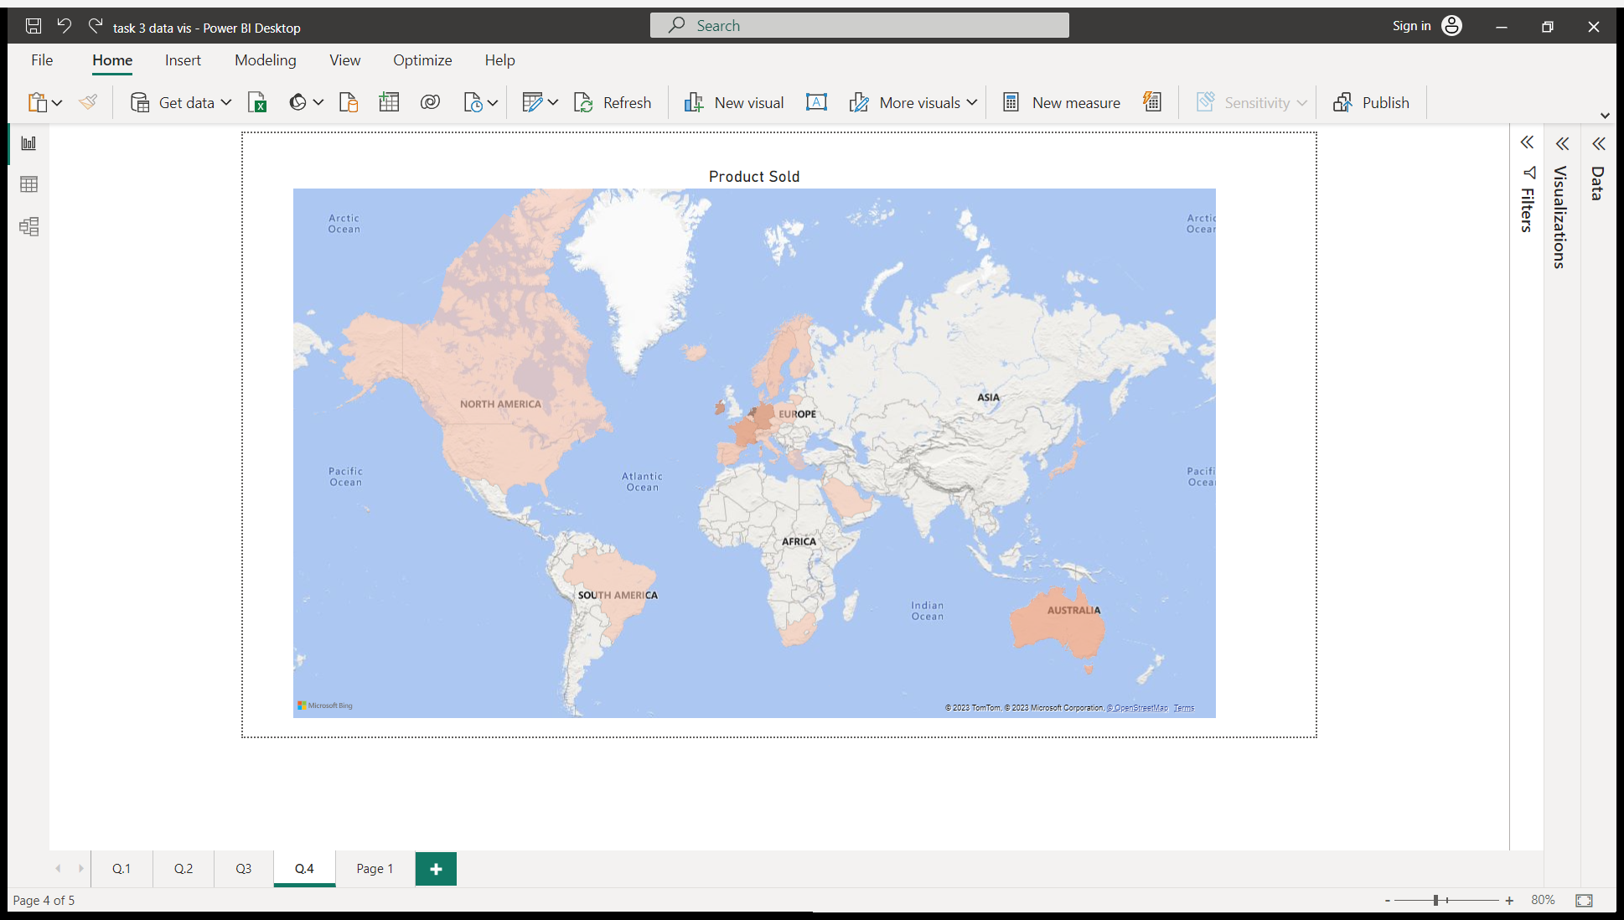
EXPLORATORY DATA VISUALIZATION

Slide 6
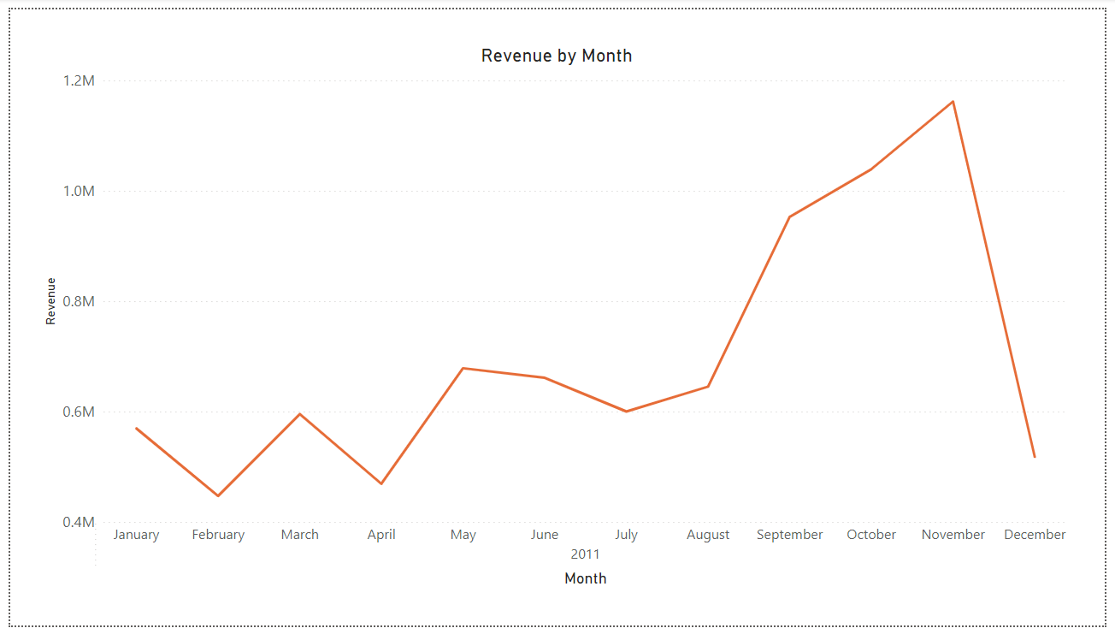

Slide 7
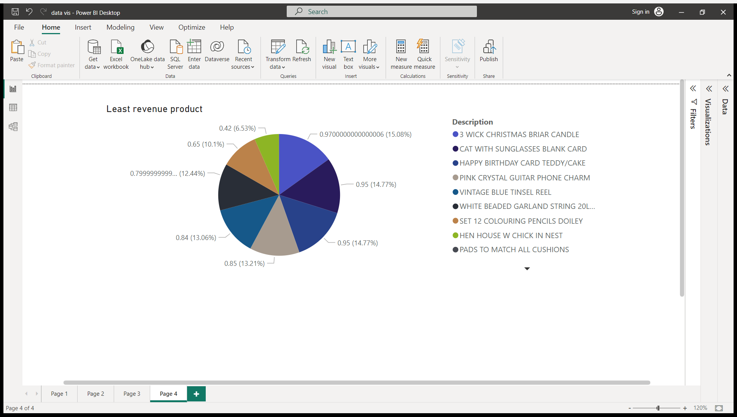
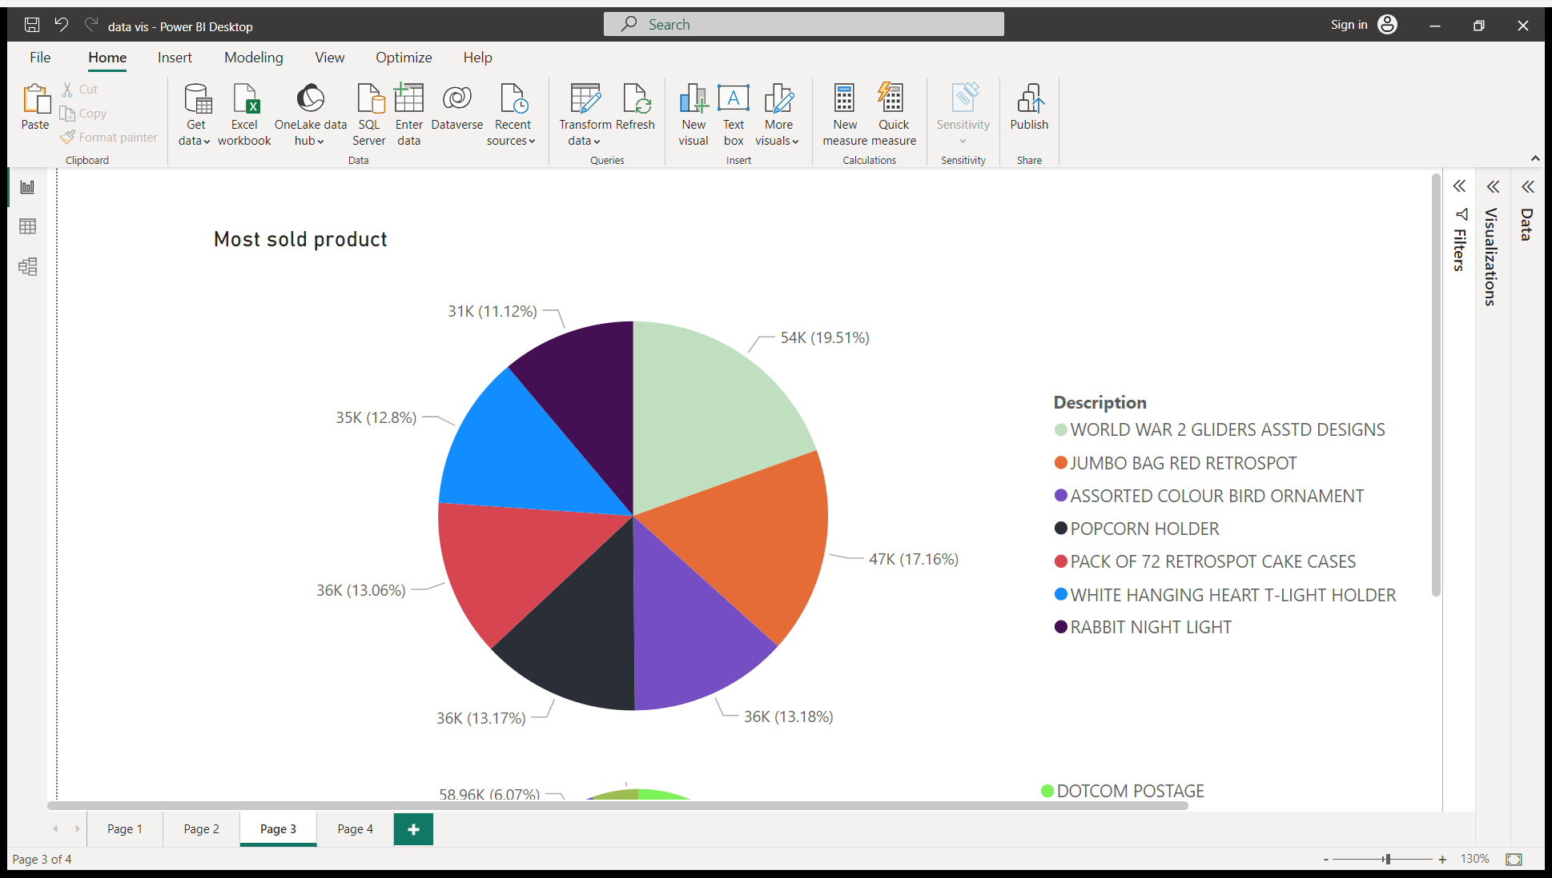
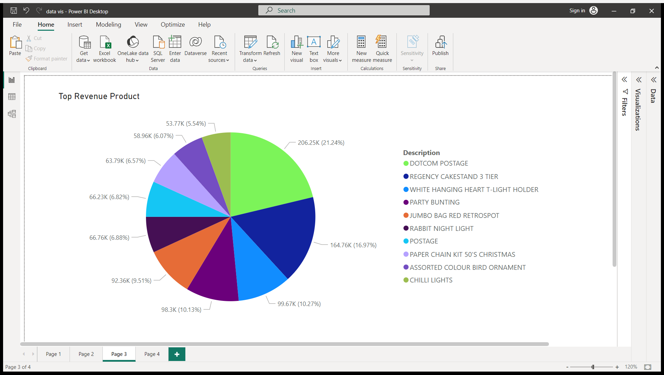

Slide 8
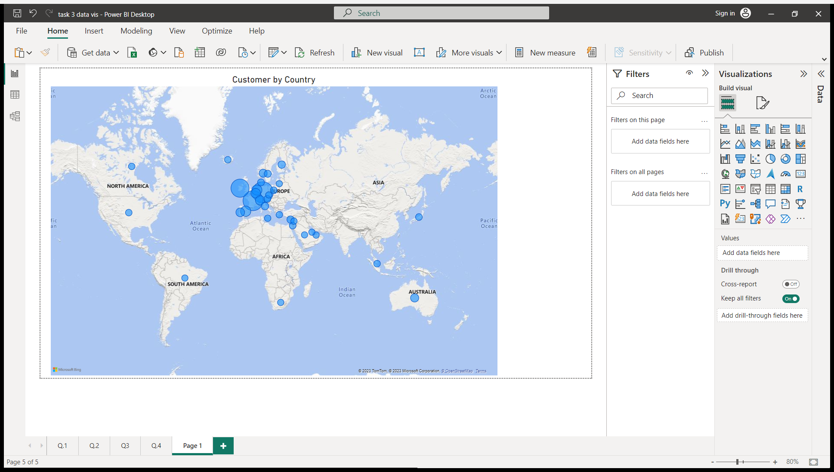
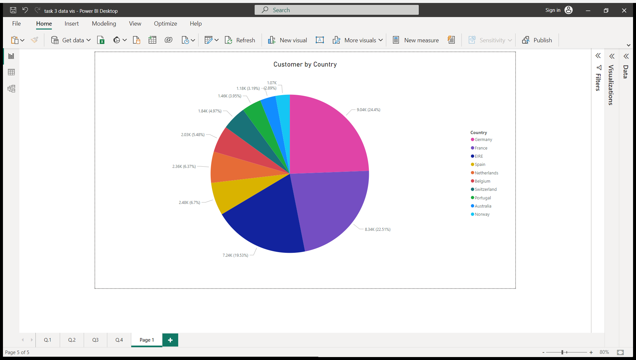

Slide 9
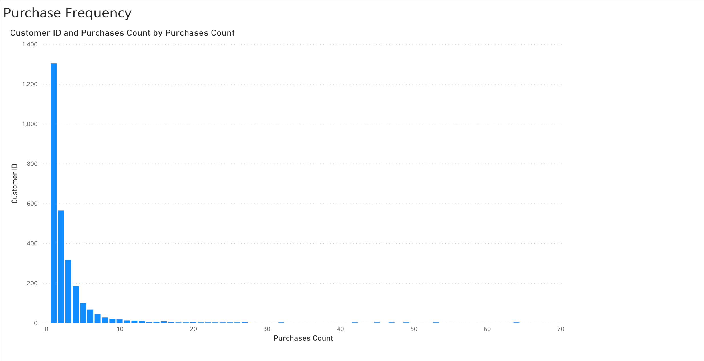
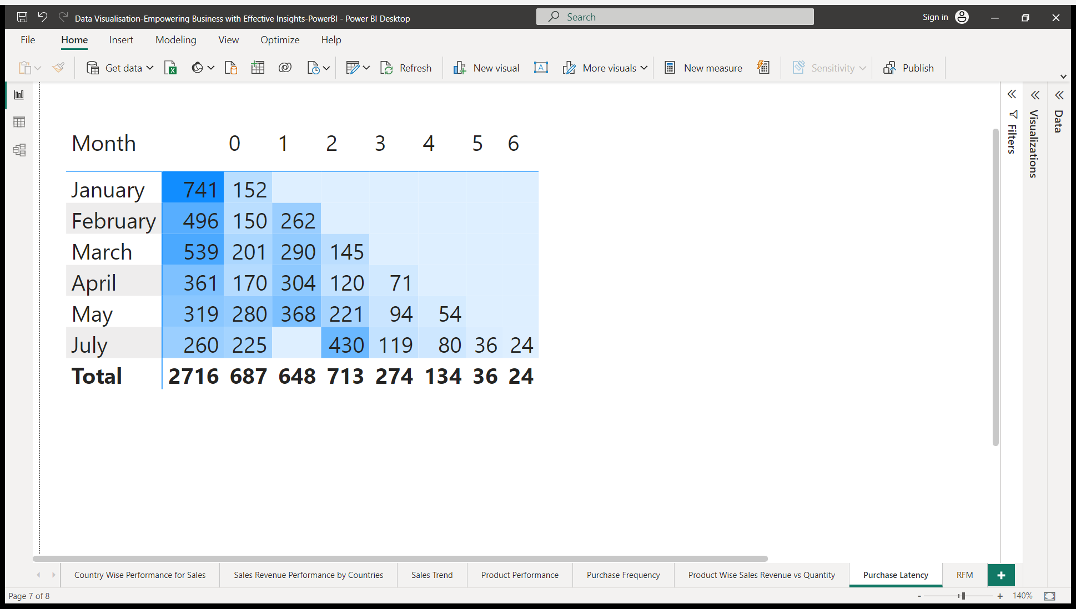

Slide 10
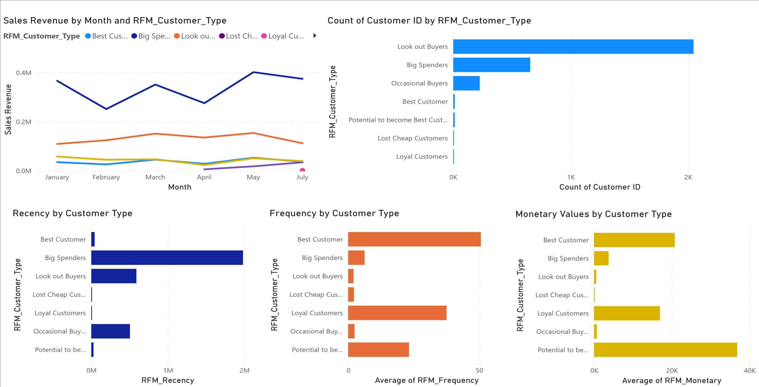
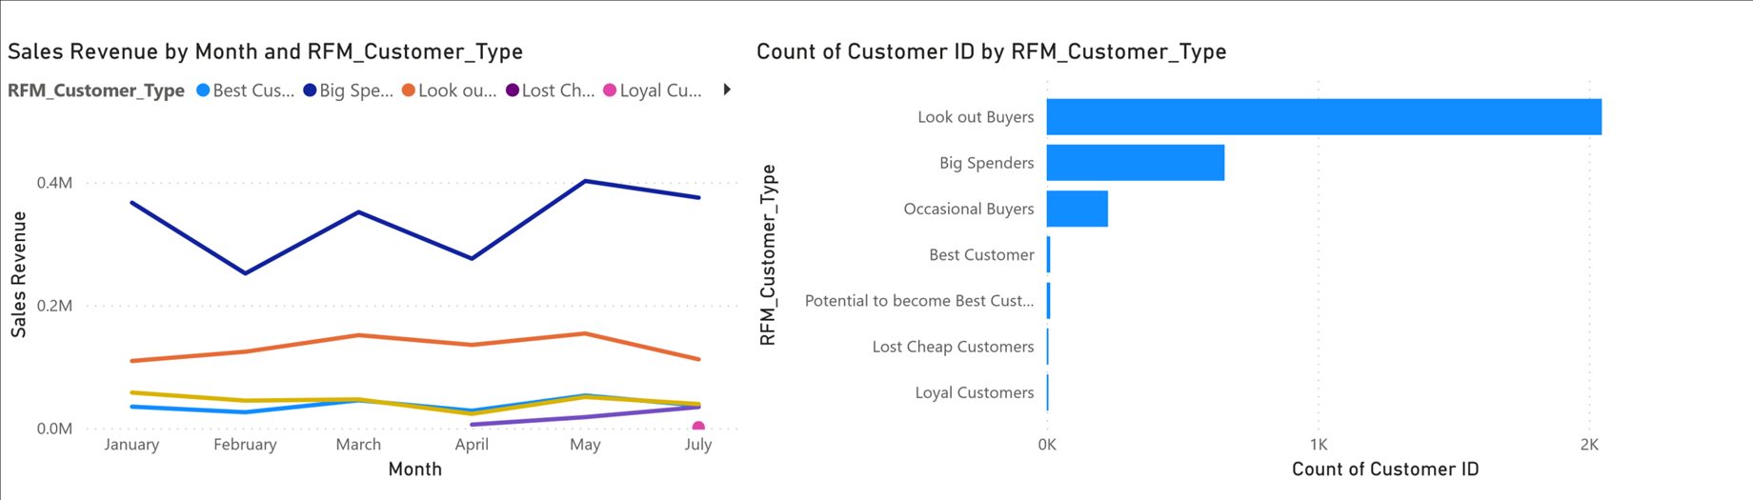

Slide 11
THANK YOU

